Slide 1


The Biological Diversity Act
& Conservation Framework
KERALA STATE BIODIVERSITY BOARD

Slide 2










Major Objectives of the BD Act
The core pillars governing the legal framework for biological diversity in India.
Conservation
Sustainable Use
Benefit Sharing
Protection and preservation of biological diversity.
Utilization without leading to long-term decline.
Equitable Access and Benefit Sharing from resource utilization.

Slide 3




Three-Tier Implementation Framework
Institutional mechanism for the decentralized management of biological resources.
National Level
National Biodiversity Authority (NBA)
Nodal agency for regulatory functions at the central level.
State Level
State Biodiversity Boards (SBBs) / UTBCs
Coordinating conservation strategies across states.
Local Level
Biodiversity Management Committees (BMCs)
Grassroots implementation within local bodies.

Slide 4












Key Conservation Sections
Legal framework for Biodiversity protection (Sections 36 to 44)
SEC. 36, 36A, 36B
SECTION 37
SECTION 38
Strategies & Plans
Heritage Sites
Threatened Species
National and State strategies for biodiversity conservation and promotion.
Notification of areas as Biodiversity Heritage Sites (BHS) in local areas.
Identification and notification of species on the verge of extinction.
SEC. 39 & 40
SECTION 41
SEC. 42, 43 & 44
Repositories & NTCs
BMCs
Biodiversity Fund
Designating repositories and exempting Normally Traded Commodities.
Establishment and functions of Biodiversity Management Committees.
Constitution and utilization of the Local Biodiversity Fund (LBF).

Slide 5










National Strategies and Plans
SECTIONS 36, 36A & 36B OF THE BD ACT
Section 36: Central Govt. Mandates
Section 36A: NBA
Monitor and regulate access to biological resources from foreign countries.
Develop NBSAPs for conservation and sustainable use.
Identification and monitoring of biological rich areas.
Section 36B: State Govt.
Integration of BD into sectoral policies and EIA measures.
Develop SBSAP (KBSAP 2025) &
One Step Ahead - LBSAP for local level conservation.
Protection of Traditional Knowledge (TK).
NBSAP TIMELINE
1999
2008
2014
2024
"National stewardship: Protecting biodiversity for future generations."

Slide 6


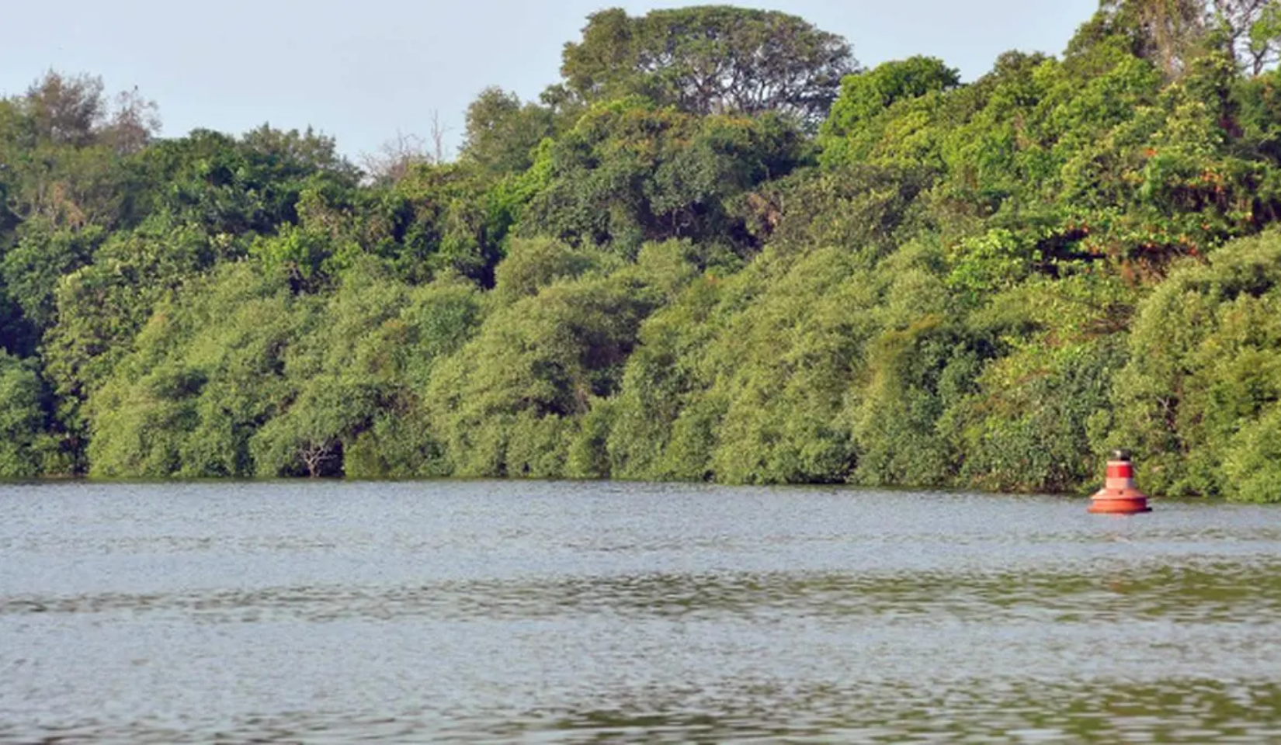




Biodiversity Heritage Sites (BHS)
Section 37 of the BD Act & Rule 19 of State Rules 2008
Areas of unique biological importance notified in consultation with local bodies and BMCs.
53
10
NATIONAL BHS
LOCAL BHS
Kerala Initiatives
•
Asramam Mangrove, Kollam (First notified in 2019)
•
Proposals: Kalasamala, Edayilakkad Kavu & CUBG
Asramam Mangrove in Kollam, Kerala
•
LBHS: A pioneering State Initiative (10 BMCs declared)

Slide 7






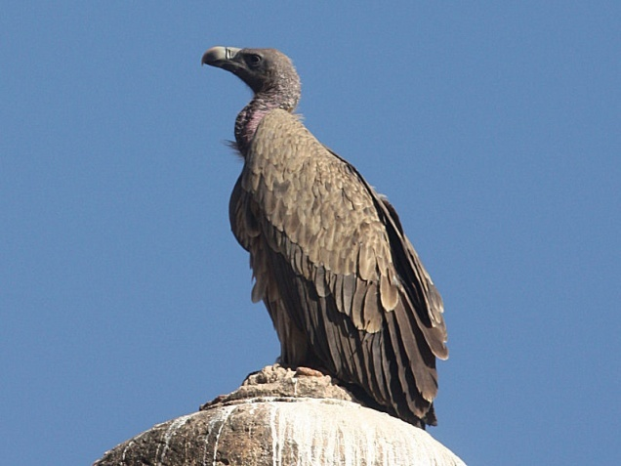
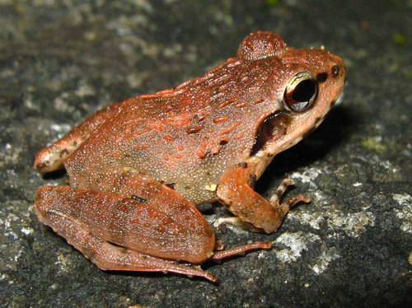



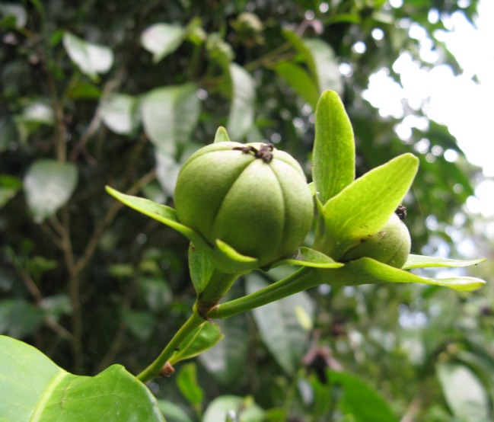
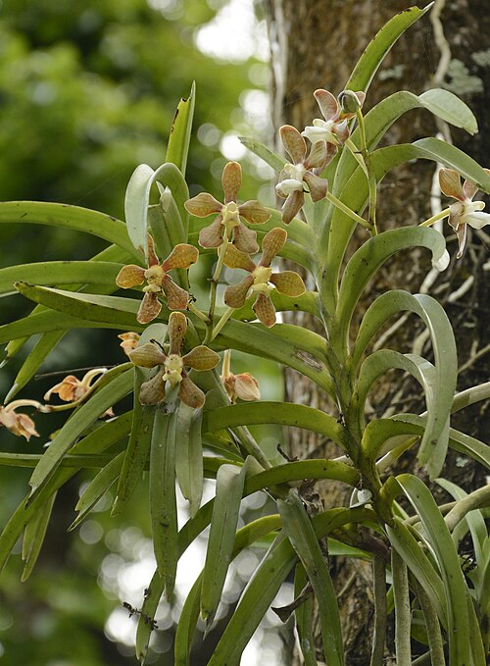
Threatened Species Protection(Section 38)
District Level Conservation
Notifying any species on the verge of extinction/ likely to become extinct in the near future.
G.O. 13.10.2025: Dist. Panchayat BMCs can declare unique district species.
Consolidated into the State Red Data Book for targeted protection.
Regulatory Purpose
To regulate or prohibit the collection of species on the verge of extinction, ensuring their preservation in natural habitats.
2009 – Notified 39 Species
26 Plants
13 Animals

Slide 8







Repositories and NTCs
Legal Designations under Sections 39 & 40
Section 39
Section 40
Designated institutions for conservation of biological resources.
Power to exempt certain biological resources,
Must maintain representative samples as voucher specimens.
Includes NTCs & Cultivated Medicinal Plants.
BMCs to provide Certificate of Origin.
Covers different categories of biological resources.
17
421
INSTITUTIONS DESIGNATED
SPECIES NOTIFIED AS NTC

Slide 9





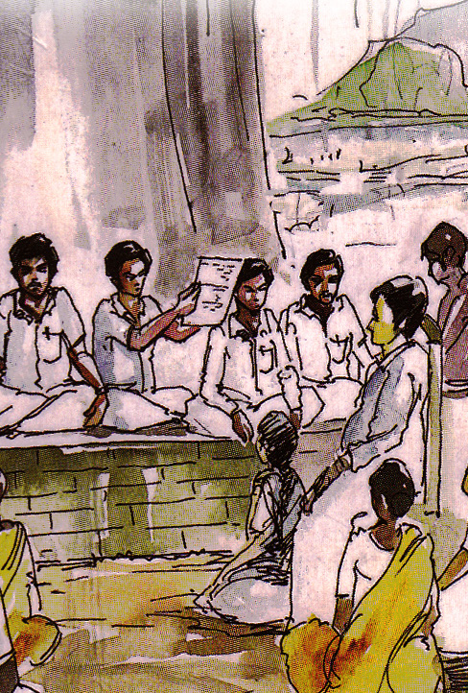














Biodiversity Management Committees
TOTAL REACH
1200 Local Bodies
Statutory Structure & Membership
Core Composition
Total Local bodies
National level – 2,77,688
State level - 1200
11
Co-terminus with local body
Total Members
Period of BMC
Chairperson
Chair of the Local Body
Member Secretary
BMCs ensure decentralized governance by involving local communities and traditional knowledge holders in biodiversity management.
Secretary of the Local Body
NOMINATED MEMBERS - 9
TK Holders
Farmers
Fisher folk
Academicians
NTFP Collectors

Slide 10











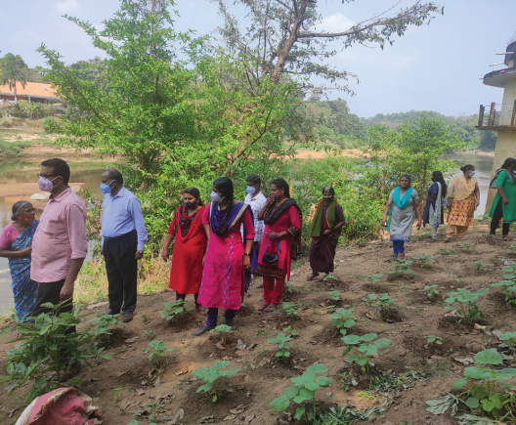
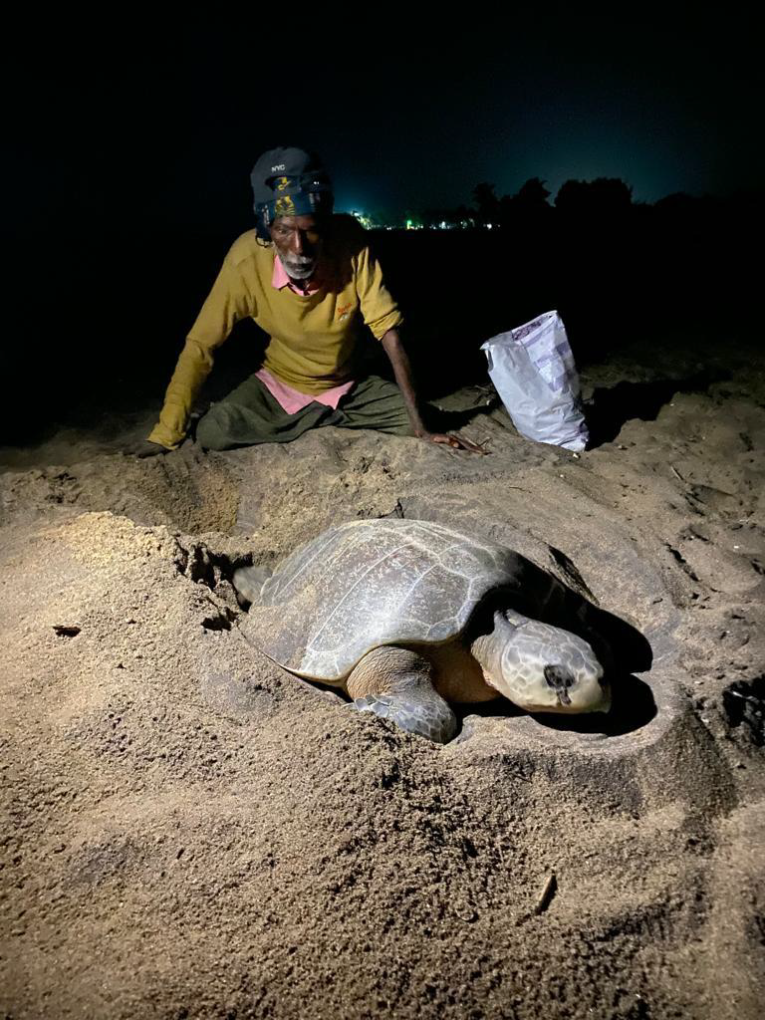





BMC Functions & Local Biodiversity Fund
Core Functions (Sec 41)
LBF Sources (Sec 43)
Conservation: Habitats, landraces, folk varieties.
Govt./NBA Grants
Levies & Fees
Documentation: TK and PBR preparation.
Sustainable Use: Managing biological resources.
Benefit Sharing
State Loans
Levy Collection: Fees for resource access. (Sec. 41(3))
LBF Utilization (Sec 44)
Conservation & Area Restoration
Socio-economic Development
Administrative Expenses of BMCs
Sl. No. | Quantity of the biological resources collected | Levy to be imposed (Rs.)
1 | Up to 1000 Kg | 100/-
2 | 1000-5000 Kg | 500/-
3 | 5000-10000 Kg | 1000/-
4 | 10000-25000 Kg | 2000/-
Total PBRs prepared – 1034
Updated PBRs – 93
E-PBR - Initiated

Slide 11
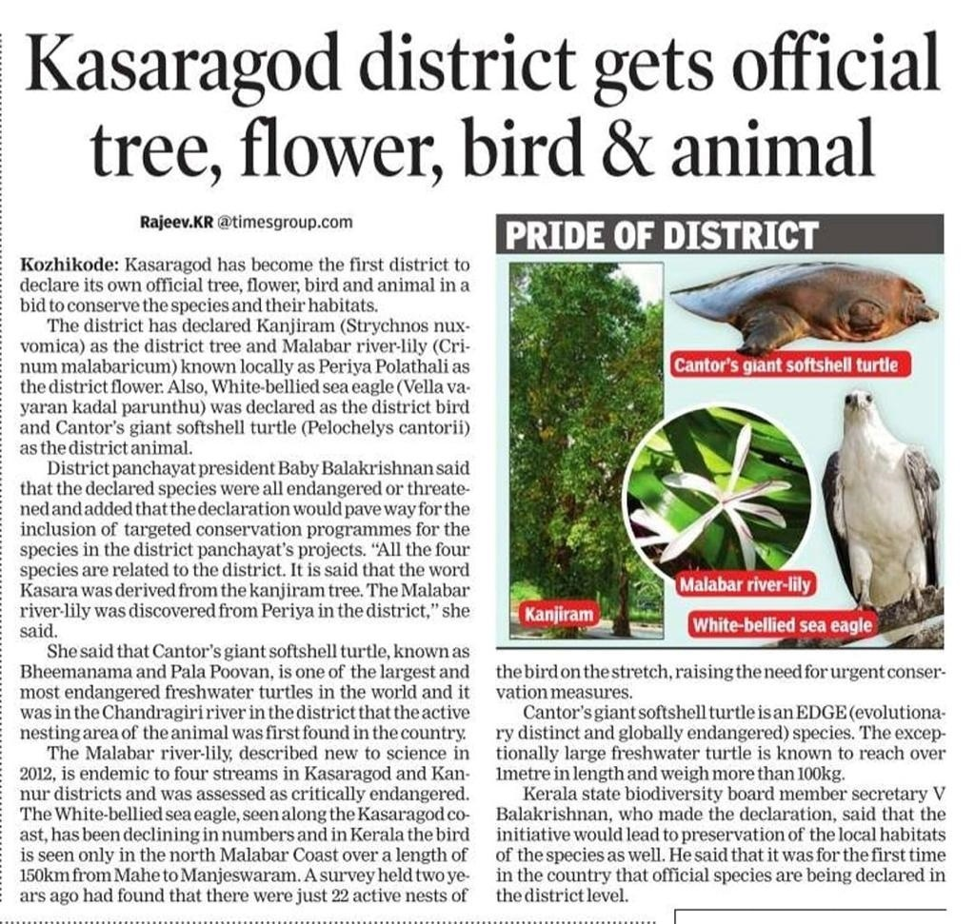
BMC level Actions:
Ensure Conservation & Sustainable Utilization (Sec 41)
Thavinhal GP – Regulation of cutting of Ochlandrae Sps.
Panathady GP – Regulation of Erankol & Miss Kerala
Thavinhal GP – Regulation of catching inland fishes
Vengappally GP – Regulation of Quarries
District Species Declaration – Kasaragod, Kozhikode & Wayanad Districts
Kasaragod – Flower, Tree, Bird, Animal (2023) & Bedakam Coconut, Vechoor Cow (2025).
Kozhikode – Flower, Tree, Heritage tree, Animal, Water animal, Bird, Butterfly, Fish (2025).
Wayanad – Mammal, Bird, Butterfly, Fish, Dragon Fly, Retile, Amphibian, Heritage tree, Tree & Flower (2025).

Slide 12
Strengthening of Act Implementation in Kerala:
BMCs as Envtl. Watch Group (2013)
State level Steering Committee (2018)
Working Group (2018)
LBHS (2020)
PBR Quality Evaluation (2021)
DBCC (2022)
Virtual BD Cadre (2023)
BMC Sitting Fee (2025)
TSG Honorarium (2025)
District Species Declaration (2025)

Slide 13
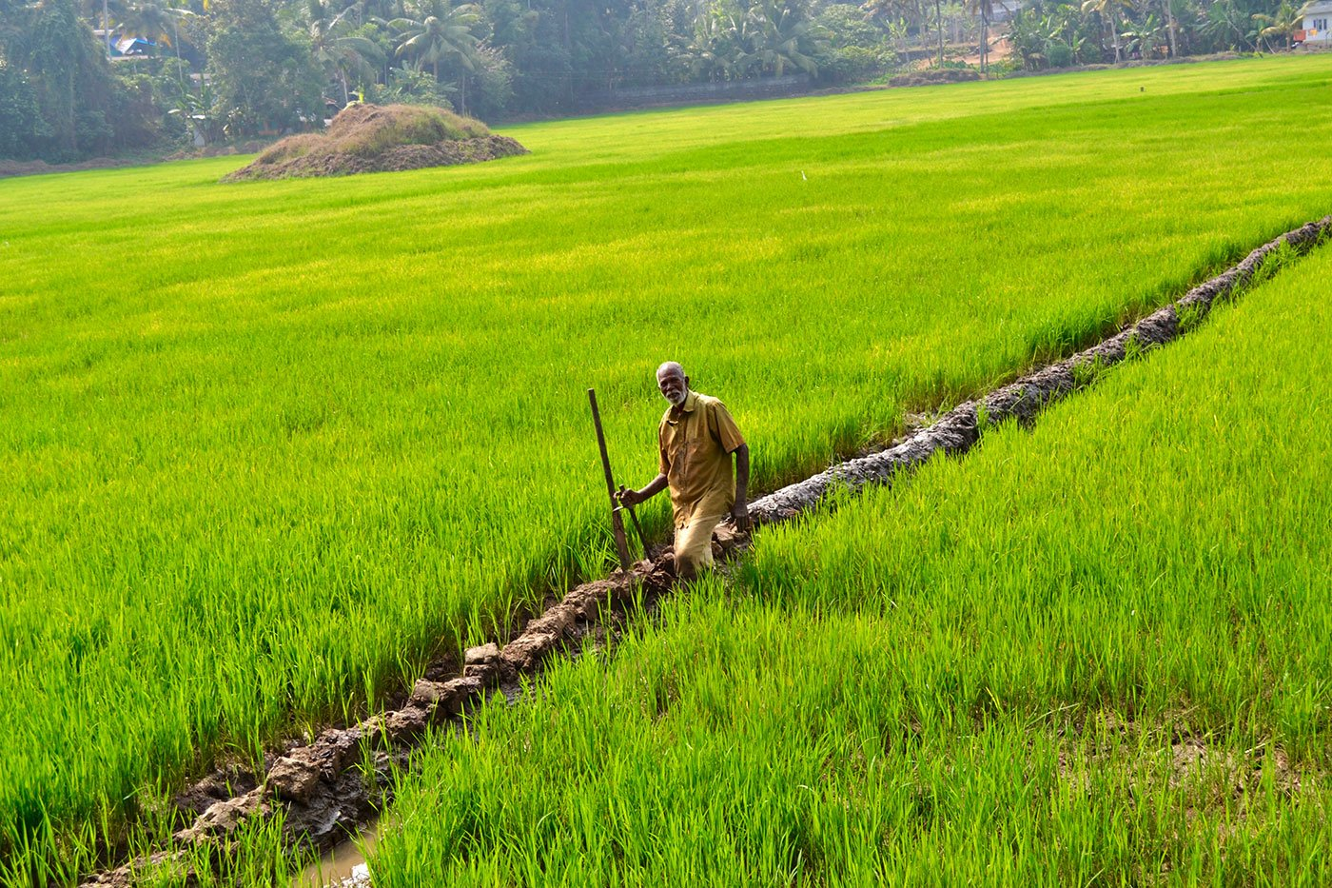
THANK YOU

